Slide 1
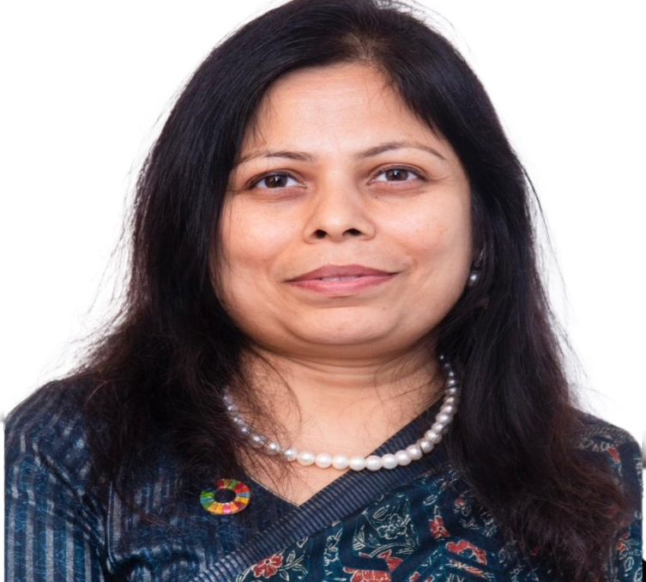
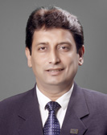
The Institute of Chartered Accountants of India (Set up by an Act of Parliament)
Women & Young Members Excellence Committee
Organises
Sky High Symposium-68
CA. Priti Paras Savla
Chairperson, WYMEC, ICAI
CA. Abhay Chhajed
Vice Chairman, WYMEC, ICAI

Slide 2
Welcome

Slide 3
Professional Growth through Life Skills and Emotional Management
Notes:
Yes set
Snoga

Slide 4
Professional Growth through Life Skills and Emotional Management
Emotions
We live in Emotions
I am not alone who cant handle emotions
Emotions are not weakness
Notes:
Yes set
Snoga

Slide 5
In our time together
Emotions
How to handle Emotions
Notes:
Yes set
Snoga

Slide 6
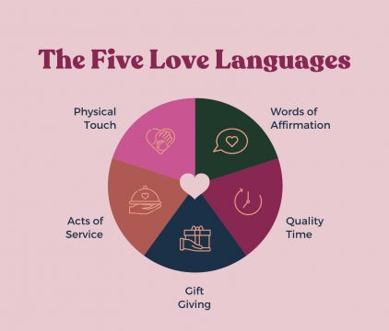
In our time together
Some tools to understand human behaviours
Wheel of Life
h
6 Human Needs
Communication Model
5 Love Languages
Notes:
Yes set
Snoga

Slide 7
Emotional Management

Slide 8
Professional Growth
Who feels ki hum ek area me better karenge to dusra area rah jayega?

Slide 9
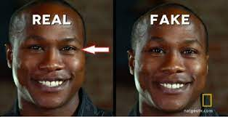
Emotional Management

Slide 10
Professional Growth
We will be better version of ourselves in each are of our life
Intention setting

Slide 11
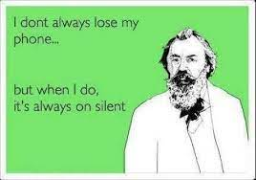
Rules for today

Slide 12
Professional Growth
Man power
Clients Complaints
Emergencies
Deadlines
Area Of Expertise
Low profits

Slide 13
Professional Growth
Freinds
Home
Financial
Social
Children
Health

Slide 14
Event causes Emotions
We feel positive or some so called negative emotions jinko ki we don’t want to feel
Mainly ASHFG

Slide 15
Fact
Stress does not differentiate between reason of stress
Stress = Response of our body to a given situation
Notes:
Movie dekhte hain, mind ko pata hota hai ki story hai par hamko effect hota hai.

Slide 16
Fact
Stress does not differentiate between reason of stress
Event is not a problem
Our relationship to that event is problem
Notes:
Story of Gali to 2 different persons.
How to solve it. Guided meditation for inner child.

Slide 17
Check Yourself
Do you exhibit your behaviour as per your choice? Or your emotions compel you to do the same
Notes:
Story of Gali to 2 different persons.
How to solve it. Guided meditation for inner child.

Slide 18
Some are always happy Some are always angry Some are emotional aware
Notes:
Story of Gali to 2 different persons.
How to solve it. Guided meditation for inner child.

Slide 19
Emotional intelligence can have a surprisingly powerful effect
on our lives, foster long-term relationships with friends and romantic partners to success in school and pursue meaningful work that gives us a sense of purpose.
Notes:
Story of Gali to 2 different persons.
How to solve it. Guided meditation for inner child.

Slide 20
Bosses who act in ways associated with emotional intelligence foster happier, more creative employees, according to a Yale-led study in the Journal of Creative Behavior.
Notes:
Story of Gali to 2 different persons.
How to solve it. Guided meditation for inner child.

Slide 21
Wheel of Life
6 Areas of Life
Physical Health
Mental/ emotional Health
Career
Wealth
Family
Social
Notes:
Story of Gali to 2 different persons.
How to solve it. Guided meditation for inner child.

Slide 22
Wheel of Life
Give marks from 10 in
terms of satisfection
6 Areas of Life
Physical Health
Mental/ emotional Health
Career
Wealth
Family
Social
8
7
1
6
8
8
Notes:
Story of Gali to 2 different persons.
How to solve it. Guided meditation for inner child.

Slide 23
Wheel of Life
Physical Health
Notes:
Story of Gali to 2 different persons.
How to solve it. Guided meditation for inner child.

Slide 24
Wheel of Life
Physical Health
Emotionall Health
Notes:
Story of Gali to 2 different persons.
How to solve it. Guided meditation for inner child.

Slide 25
Wheel of Life
Physical Health
Emotionall Health
Family
Notes:
Story of Gali to 2 different persons.
How to solve it. Guided meditation for inner child.

Slide 26
Wheel of Life
Physical Health
Emotionall Health
Family
Social
Notes:
Story of Gali to 2 different persons.
How to solve it. Guided meditation for inner child.

Slide 27
Wheel of Life
Physical Health
Emotionall Health
Career
Family
Social
Notes:
Story of Gali to 2 different persons.
How to solve it. Guided meditation for inner child.

Slide 28
Wheel of Life
Physical Health
Wealth
Emotionall Health
Career
Family
Social
Notes:
Story of Gali to 2 different persons.
How to solve it. Guided meditation for inner child.

Slide 29
Wheel of Life
Physical Health
Wealth
Emotional Health
Career
Family
Social
Notes:
Story of Gali to 2 different persons.
How to solve it. Guided meditation for inner child.

Slide 30
Wheel of Life
Physical Health
Wealth
Emotionall Health
Career
Family
Social
Notes:
Story of Gali to 2 different persons.
How to solve it. Guided meditation for inner child.

Slide 31
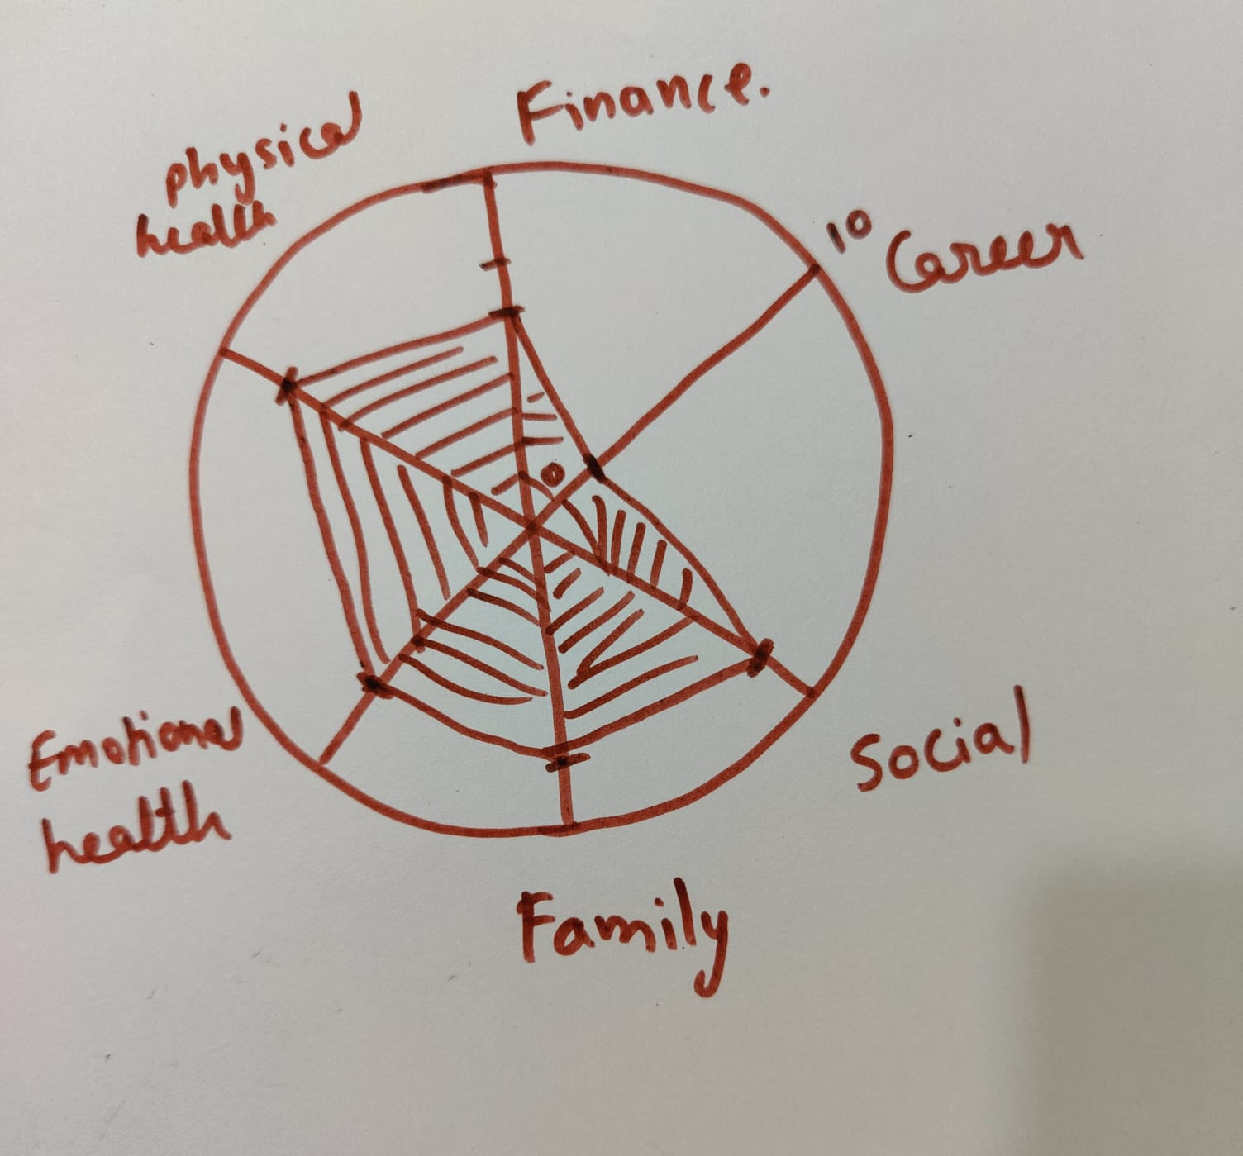
Wheel of Life
Wealth
Family
Social
Notes:
Story of Gali to 2 different persons.
How to solve it. Guided meditation for inner child.

Slide 32
Six Human Needs
Variety
Love and Connection
Certainity
Certainity
Significance
Growth
Contribution
Notes:
Story of Gali to 2 different persons.
How to solve it. Guided meditation for inner child.

Slide 33
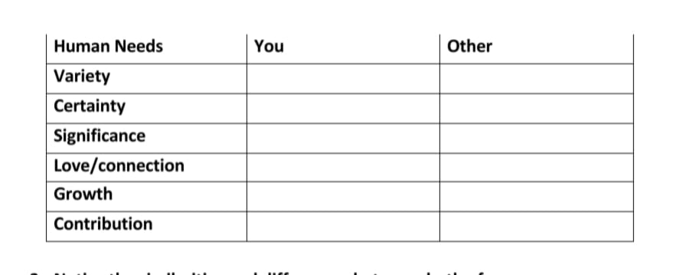
Six Human Needs
Fill in the table below:-
Rate yourself based on your human needs,
where 10 is a high requirement for that human need and 1 is not a high need at all.
Rate someone you love in a similar manner
Notice the similarities and differences between both of you.
Notes:
Story of Gali to 2 different persons.
How to solve it. Guided meditation for inner child.

Slide 34
Notes:
Story of Gali to 2 different persons.
How to solve it. Guided meditation for inner child.

Slide 35
Notes:
Story of Gali to 2 different persons.
How to solve it. Guided meditation for inner child.

Slide 36
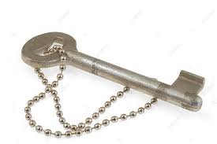
One Key for all
Notes:
Story of Gali to 2 different persons.
How to solve it. Guided meditation for inner child.

Slide 37
Feel your Emotions to Heal Your Emotions
Notes:
Story of Gali to 2 different persons.
How to solve it. Guided meditation for inner child.

Slide 38
Feel your Emotions to Heal Your Emotions
Observe your body
Feel the Emotion
Note the Intensity and give number from 10
Breath in the emotion or body part
It will get settle in some time
Notes:
Story of Gali to 2 different persons.
How to solve it. Guided meditation for inner child.

Slide 39
Emotional Washroom
Notes:
Story of Gali to 2 different persons.
How to solve it. Guided meditation for inner child.

Slide 40
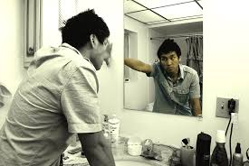
Emotional Washroom
Notes:
Story of Gali to 2 different persons.
How to solve it. Guided meditation for inner child.

Slide 41
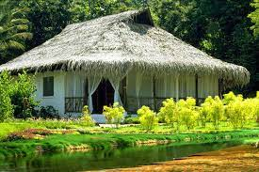
Emotional Washroom
(Kop Bhawan)
Notes:
Story of Gali to 2 different persons.
How to solve it. Guided meditation for inner child.

Slide 42
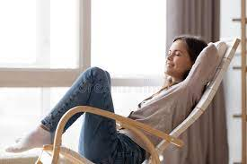
Rocking Chair
Notes:
Story of Gali to 2 different persons.
How to solve it. Guided meditation for inner child.

Slide 43
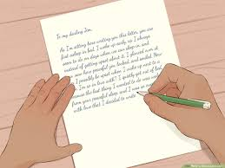
Rocking Chair
Letter to Self
Notes:
Story of Gali to 2 different persons.
How to solve it. Guided meditation for inner child.

Slide 44
Keep Doing?
Stop Doing
Next Steps

Slide 45
Keep Connected
Instagram – seematayal7
Facebook - Seema Tayal
Youtube - Seema Tayal
Notes:
Story of Gali to 2 different persons.
How to solve it. Guided meditation for inner child.

Slide 46
Thank yourself

Slide 47
Question and Answe﻿r...

Slide 48
Thank You
Women & Young Members Excellence Committee
011-30110573
wmec@icai.in
www.wmec.icai.org
ICAI Bhawan,
3rd Floor, Annexe Building
Indraprastha Marg, New Delhi

